Slide 1
First year practicals
Lab 3: The Navon (1977) task Seeing the forest before the trees

Slide 2
Objectives of this class
In this class you will learn about;
Writing a report (mimicking a journal article)
Navon’s study (1977) of global versus local processing in perception

Slide 3
Why write a report?
One aspect of the lab course is to develop skills in experimental design, data analysis, interpretation etc.
However we need to be able to express these ideas/skills within a written form
The lab report!
By writing reports in your 1st year you will develop a better writing style and through feedback, will learn how to structure a good report.
This will be invaluable for your 2nd & 3rd years.

Slide 4
Why write a report?
The aim of a lab report is to indicate to the reader the following:
Why did you bother?
How did you do it?
You should ask yourself “Could someone replicate my experiment using the information I have provided them with?”
What did you find?
What were the results of your investigation?
So what?
How do your results relate to your hypothesis & what theoretical contribution do they make?

Slide 5
Standard approach
Sometimes reports (certainly some published papers!) can be lengthy. To reduce the time looking for specific information we rely on a standard structure for a report.
Not every published paper contains all of the following sections/sub-sections, but you should include them if they are relevant.

Slide 6
Sections of a lab report
Title
Abstract
Introduction
Method
Design
Participants
Apparatus & Materials (optional)
Procedure
Scoring (optional)
Results
Discussion
References
Appendix (optional)
You will see these sections referred to on the feedback coversheet which markers use to help you to improve your reports!

Slide 7
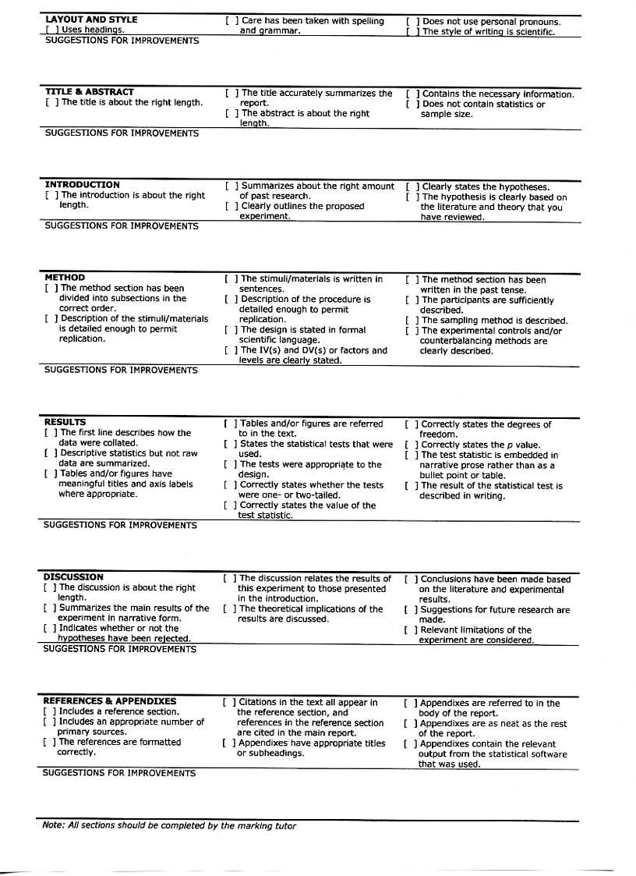

Slide 8
Title
This is the first thing someone reads and so should summarise the content of the report using no more than 20 words
Gives some indication of the overall theme of the work that is to be reported
Catchy titles should generally be avoided, as should titles using superfluous words
An Empirical Investigation into Obsessive Compulsive Disorder in Children with High Socioeconomic Status Parents.
Obsessive Compulsive Disorder in Children with High Socioeconomic Status Parents.
NB: Capitalize major words & centre the title at the top of the page

Slide 9
Title
Don’t be too vague
The ‘Beer-Goggles’ Effect.
Don’t be too specific
An Investigation Into the Effects of Drinking 6 Pints of Guinness in a Nightclub in Brighton at 11:30, While Listening to Drum and Bass Played at 100 db Through a Good Sound System, on 12 Men’s and 15 Women’s Ability to Accurately Judge the Attractiveness of Members of the Opposite Sex.

Slide 10
Title
About right
The ‘Beer-Goggles Effect’: The Effects of Alcohol on Attractiveness Ratings of the Opposite Gender.
Sometimes it is useful to refer to the things you are manipulating (the IV) & what you are measuring (DV) within the title
The example above does just this
IV = Alcohol (as levels are manipulated in this study)
DV = Ratings of attractiveness

Slide 11
Abstract
The abstract is a short précis (about 100-150 words) of the study that is about to be presented below it
It is often what a reader will use to determine whether to bother to read the rest of the study
E.g. A literature search online will often provide the abstract of the paper

Slide 12
Abstract
It should ideally contain
a brief statement of the problem being investigated & motivation for the study
the participants investigated
the experimental method of study
the principal findings/results obtained
the main conclusions drawn
Try not to finish with empty statements such as ‘The findings were discussed’.
It is normally easier to write the abstract last, once you know what key points of the study should be summarised.

Slide 13
Beer-Goggles example abstract
Ugly (1993) has shown that the propensity to misclassify members of the opposite sex as attractive is increased in nightclub settings. This study was designed to ascertain whether this effect is due to the dim lighting employed in these venues, or the consumption of alcohol in this setting. Ratings of the attractiveness of a set of stooge participants were taken in both a well-lit and dimly-lit nightclub by both sober and drunk participants. A 2 way ANOVA revealed a significant effect of alcohol consumption, but not of the lighting used. The results suggest that, contrary to Ugly’s hypothesis, dim lighting does not contribute to the inflated attractiveness of opposite-­‐gender mates; instead these ratings are influenced solely by alcohol intake.
You can see that this abstract is short, but summarises what was done and why, and finishes with what was found from the results and how this fits with previous studies/theories.

Slide 14
Introduction
An introduction is a little like writing an essay
It should try to answer the following questions:
Broadly introduce the area you are investigating. You may need some definitions
What has been done in this area of psychology before? In other words, review the current literature (theories/findings) about the topic you are investigating. Are their any inconsistencies/problems in the research so far?
What was the point/purpose of your study?

Slide 15
Introduction
State your hypothesis explicitly (but informally) towards the end of your introduction. This often means making reference to the IV(s) & DV (but informally)
E.g. ‘This study looks at whether the amount of alcohol drunk and the gender of the consumer has an effect on the attractiveness of the mate selected.’
What do you expect or predict may happen? If you have an expectation then say so.
E.g. ‘Based on previous research discussed earlier, it is predicted that attractiveness ratings will increase as alcohol amount increases, but only for males. Attractiveness ratings made by female participants are not expected to be influenced by alcohol consumption.’

Slide 16
Introduction – Providing a rationale
Possible reasons/rationale for a study
To support/test a specific theory/idea
To replicate/confirm an existing finding
A replication with a different sample
To extend the findings of previous research
Often a replication with a change in method
State what differences are between your study and an existing study
To distinguish between different theories or resolve an anomaly (e.g. Contradictory results from previous studies)
To plug as gap in existing knowledge
The introduction doesn’t need a separate heading
TIP: Do not state the null hypothesis in the introduction. You can assume that the reader knows what a null hypothesis is.

Slide 17
Method
Someone should be able to repeat your experiment by reading this section!
Include enough information for replication of the study, but avoid superfluous information
E.g. ‘A pencil and paper were used to record the participant’s gender’.
The Method always has clearly labelled sub-sections, but these do vary according to the type of experiment and the Journal type
E.g. You may not always need an apparatus section (unless, for example, you used a MRI scanner and wanted to report the details about it)

Slide 18
Method –sub-sections
Design
Participants
Apparatus and/or Materials (optional)
Procedure
Scoring (optional)
Sometimes the order of these sub-sections will be different if you pick up an academic paper. Try to stick with the order above.

Slide 19
Design sub-section
Here you should formally describe the type of design being used (using psychological design language)
This is more often the case for an experimental design where IVs are manipulated and DVs measured. Not all designs (e.g. correlational) have IVs!
Directly mention and define all IV(s)/DV(s).
Remember to report units of measurement for DVs!
Conditions of the design should be mentioned and how they were manipulated
E.g. Design type might be a between-subjects design

Slide 20
Design sub-section
How many participants were tested under each condition?
Any design controls should be mentioned here.
E.g. If the design counterbalanced for the ordering of two conditions, then say so.
How did you assign participants to conditions (or orders of conditions)?

Slide 21
Design sub-section
Example:
‘A repeated measures design was used. There were two independent variables: the lighting used in the nightclub (bright or dim) and the level of alcohol consumed (none or 6 pints). There were two dependent variables that were analysed separately: the participant’s ratings of physical attractiveness (the COAR scale) and their ratings of the attractiveness of personality (the CRAPS scale). Participants took part in all four conditions of the experiment.’

Slide 22
Participants sub-section
So who were tested in your experiment?
What age and gender were they?
How did you select them?
A random sample?
A snowball sample?
A convenience sample?
How many of them were there?
Were there specific characteristics (selection criteria) of the people you tested that should be mentioned?
E.g. All participants were right handed and bilingual.
Only mention such things if they are important to your study

Slide 23
Participants sub-section
Example:
‘Fifty participants completed all conditions of this study: 25 were male and 25 female. Ages ranged from 18 to 39 years (M = 24.26, SD = 3.52 years). Participants were all undergraduate students at the University of Sussex who took part in return for free admission to the nightclub. All participants were naive to the purpose of the experiment.’

Slide 24
Apparatus / Materials sub-section
This section describes the apparatus and materials used in testing the participants
Apparatus includes specialist equipment e.g. An Apple Mackintosh computer running E-Prime.
Clear sentences should be used to describe apparatus/materials and not bulleted lists!
Sometimes a Stimuli section is used to describe the stimulus materials that participants responded to
E.g. Stimuli were four geometric shapes, each containing the letter A-D. Shapes were approximately 2cm wide by 2cm high and were presented in red.
Sometimes you might find it easier to give some visual examples of stimuli if relevant within a figure, which you can make reference to in your write-up.

Slide 25
An Example Figure
Title (in italics)
A
B
C
D
Figure 1: Examples of the four geometric shape stimuli used in the procedure (not to scale).
Caption
Reports can contain figures and/or tables and reference to any figure/table should be made in the main text of your report.
A figure can be a graph, charts, drawings, a photograph, a diagram, etc. and these elements are always referred to as a ‘figure’ and numbered consecutively. The figure should have a title/caption below it (as in the example at the top!)
Just to be awkward, tables have the title and caption above the table!!

Slide 26
More on presenting Figures/Tables
Figures/Tables often help explain things in fewer words
The reader should not have to refer to the text to understand your tables and figures: there should be explanatory figure/table captions
Figures and tables are labelled independently
E.g. Figure 1 then later Table 1 (not Figure 1 then later Table 2!)
Axes on graphs should be clearly labelled
Units of measurement should be clear
Don’t refer to ‘graphs’, ‘diagrams’, ‘pictures’, photographs’ etc. in your main report text; use the terms ‘Figure’ and/or ‘Table’

Slide 27
Procedure sub-section
This section should state how the design was implemented with the pre-mentioned participants, using the pre-mentioned design and apparatus/stimuli.
So when participants took part, what happened to them, and in what order, from the moment they began?
Mention important timings (especially important in many cognitive tasks).
Need enough detail to be able to replicate the procedure.
Only include relevant detail!
TOO DETAILED: E.g. Participants arrived 10 minutes before the start of the experiment. They were permitted, but not required, to sit. The wind was coming from the West…

Slide 28
Procedure sub-section
Very long instructions that were given to participants can be put into an appendix (but must be referred to e.g. ‘For a full transcript of the instructions, see appendix 1.’)
Shorter instructions can be included in the main procedure section.
Any emphasis within instructions about how to respond should be made clear
E.g. Participants were asked to respond as quickly as possible but were also reminded to be as accurate as they could be.

Slide 29
Results
This section provides the reader with a clear, concise summary of the data you collected and the results of any statistical tests
Normally two parts to the results (not sub-sections though!)
Describe/Present the descriptive statistics
Means, standard deviations etc. for each group/condition
Follow with inferential statistical tests you have performed to examine the data
t-tests, ANOVA results, correlations etc.
E.g. ‘An independent samples t-test was performed to examine any differences between the male and female groups. Males performed significantly faster than females (t (29) = 3.65, p < .05)
Note that italics are used for a statistic (in this case t) and for p

Slide 30
Descriptive Statistics
When referring to descriptive/summary statistics try to be consistent with APA style
M represents a mean. Mdn represents a median
SD represents the standard deviation. SE represents standard error.
Remember to use UNITS
e.g. ‘Males were faster than females on the image rotation task (Males: M = 20.1, SD = 3.6 msecs; Females: M = 30.5, SD = 7.3 msecs)
A graphical representation of summary statistics is best when there are a few means to compare
If there are lots of means/summary statistics then you may want to present them in table form

Slide 31
Results- Reporting Inferential Statistics /probabilites
Always report the following information when reporting a statistic analysis
the value of the test statistic
degrees of freedom (or number of subjects)
one- or two- tailed test
the observed value of p
whether the test result was significant
Exact probability: E.g. ‘The mean reaction time for the younger children was significantly slower than for the older children (t (14) = 12.56; p = .03, two-tailed test)
Or: ‘The mean reaction time for the younger children was significantly slower than for the older children (t (14) = 12.56; p <.05, two-tailed test)
APA suggests rounding to 2 decimal places and many authors do not use a “leading zero” for probabilities e.g. p=.54 rather than p=0.542

Slide 32
Results
Remember:
Descriptive statistics should be reported in sentence form or in a table (not a list)
Statistical tests should be reported in the standard format for that test.
You might want to check your C81MST lectures for tips on this too!
Explain what these tests mean in relation to your experiment and the predictions

Slide 33
Results – What not to do
Don’t cut and paste tables from SPSS into your results section
Don’t include statistical calculations (by hand or computer)
Don’t include raw data in the results section (You can put it in the appendix if necessary)
Don’t try to complicate your results- this section is often best to be left as clear and straightforward as possible
Don’t interpret your results at this stage – save that for the Discussion. But you should state your results in an understandable form. e.g.:
‘Males were faster than females’ is a statement about your results
‘Males were faster than females which supports the findings of Calder (1989), but is in opposition to Broad’s (1990) theory which posited that the female brain was more developed for knitting skills’ is a discussion & doesn't belong in the results section.

Slide 34
Discussion
This section is where you can interpret your findings and relate them to previous research/predictions.
Often you will make reference to material you raised in your introduction.
General structure:
State what the results are by providing a précis (in words) of the results.
Account for the findings.
Explore the implications of the findings.

Slide 35
Discussion – State main results
What were the key findings?
Were there any significant differences between conditions?
If so, then what direction were those differences in?
Do they support the hypothesis/hypotheses?

Slide 36
Discussion – Account for the results
Discuss what these results mean
You will either have
Rejected the null hypothesis (in favour of the experimental hypothesis) , or
Failed to reject the null hypothesis
If 1. then are you sure that the effect was due to your manipulation of the IV or could confounding variables explain the result?
If 2. then try to convince the reader that there is no relationship between the IV and DV.
Either way, try your best to explain the findings

Slide 37
Discussion - Implications
Are there any implications based on your results?
Are there any weaknesses of your study that may suggest factors to be improved?
Don’t tear apart your study! Constructive criticism is OK
This may pave the way to discuss any future research
Finally, conclude with a short paragraph summarising the main findings / implications

Slide 38
References
Follow the APA style of referencing
See Referencing/APA one-off lecture & the online ‘Guidelines on how to write a report’ web-page
References cited in the report (in text citations) must also appear in your end reference list (and vice-versa)
Don’t directly cite articles/books that you haven’t actually read:
Learn to use Secondary source citations
E.g. ‘Jones (1999) suggested that cats were more neurotic than dogs (as cited in Eysenck & Keane, 2006)’, then just list the source (E & K) in the end reference list.

Slide 39
References (in text)
Example 1: ‘Evidence suggests that old people cause more road traffic accidents than new drivers (Killers, 2005).’
Example 2: ‘A study by Killers (2005) highlighted that road traffic accidents were more likely to be caused by older drivers than drivers who had only recently passed their test.’

Slide 40
Marking Scheme
When assessing the practical reports the markers consider five broad issues:
Content (does the report suitably motivate, justify, analyse and evaluate the conducted research?)
Global Structure (does the report adhere to the format specified in the School’s document on writing reports?)
Local Structure (does each section of the report contain the relevant information?)
Reasoning (is there a convincing line of argument for the research conducted and a suitable conclusion drawn?)
Evaluation of evidence (is the relevant literature evaluated appropriately?)
You may also want to take a look at the Practicals Feedback Sheet (available from the School Office)

Slide 41
Final Tips
A good book
Andy Field & Graham Hole (2003). How to design and report experiments. Sage: London.
Chapter 9, p. 287 onwards
Write in the past-tense throughout (apart from any predictions made in the intro can be phrased in the future tense)
Avoid personal grammar (‘I’, ‘We’ etc.)
Thanks to Andy Field from whom much of this material has been stolen!

Slide 42
Navon’s study of Global vs Local Perceptual processing

Slide 43
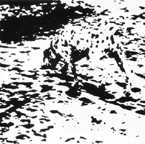
Global and local perception
Notes:
The ideas of global perception are rooted in Gestalt psychology which emphasises how the perceptual system organises and maintains a holistic image even when presented with fragments of a picture or shape.

Slide 44
Forest Before Trees: The Precedence of Global Features in Visual Perception
In a series of experiments David Navon (1977) explored the relationship between global and local perception.
Theoretical claim: “…Perceptual processes are temporally organised so that they proceed from global structuring toward more and more fine grained analysis”.
This is known as Global Precedence

Slide 45





Navon’s method- Exp. 3 of paper
Required participants to respond to either the local or global level of the stimuli.
Location of presentation varied to prevent participants from using strategies.
2 conditions: Local-directed & Global-directed
Independent variable: Consistency
Dependent variable: Reaction time in milliseconds

Slide 46
Results
Table 1. The means and standard deviations for the Global and Local directed conditions for both congruent and incongruent trials
 | Global Directed |  | Local Directed
 | Mean (ms) | Std Dev (ms) | Mean (ms) | Std Dev (ms)
Consistent | 462 | 39 | 573 | 43
Conflicting | 477 | 40 | 664 | 52
In the local-directed condition the mean reaction time was significantly greater in the conflicting than in the consistent condition (p<0.01)

Slide 47
Conclusions
“The results of this experiment suggests that the global pattern is responded to faster than the local components. Moreover, whereas people can voluntarily attend to the global pattern without being affected by the local features, they are not able to process the local features without being aware of the whole”(pg. 371, Cognitive Psychology, 9, 1977)
Navon argues that the finding that attention cannot be efficiently diverted from the whole may be interpreted as support to the notion that global processing is a necessary stage of perception prior to more fine-grained analysis.

Slide 48
Your experiment
Aims to replicate Navon’s findings for the Local Directed condition ONLY.
Same stimuli as Navon used
Varies the location that stimuli are presented on screen (top left, top right, bottom left, bottom right) making the task harder
I.V – Congruence of small/large letters
D.V. – Reaction time (seconds)

